Slide 1
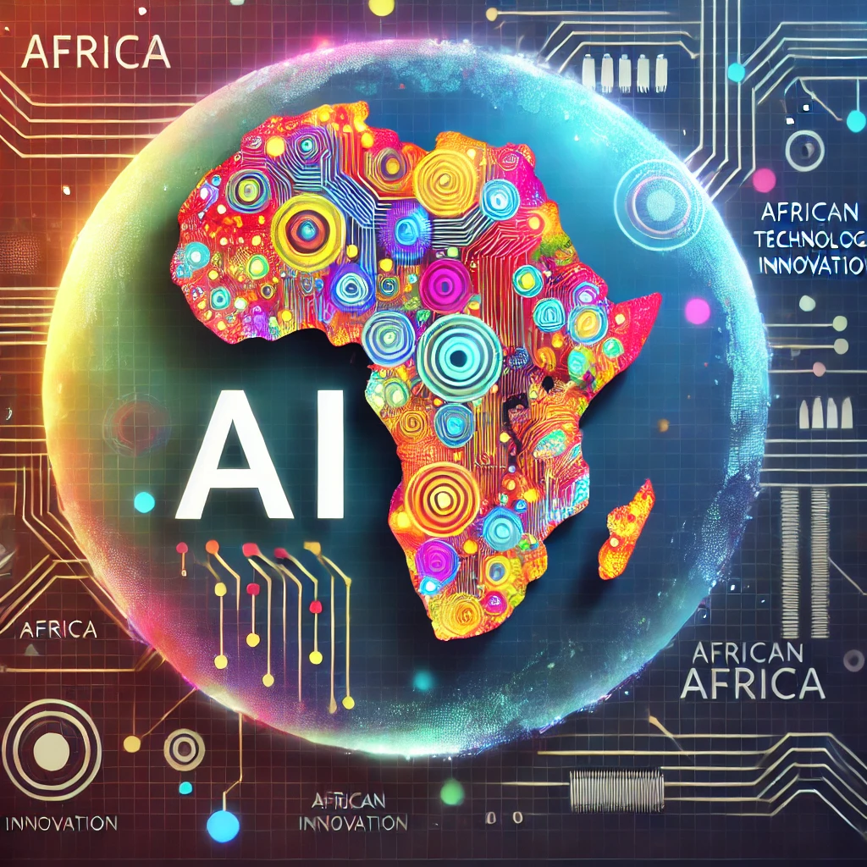
Artificial Intelligence-Powered Information Retrieval Systems in Africa
Unlocking Africa’s Potential with AI Technology
By:
Okoro Prosper Onyekachi Ph.D
5th December, 2024

Slide 2

What are Information Retrieval Systems?
Information Retrieval (IR) systems are tools designed to collect, organize, and retrieve relevant information from large datasets based on user queries.
Examples: Search engines, library databases, and recommendation systems.
Benefits:
- Quick access to information.
- Enhanced decision-making.
- Improved efficiency in knowledge acquisition.

Slide 3

What is Artificial Intelligence?
AI is the simulation of human intelligence by machines, enabling them to learn, reason, and adapt.
Key Areas:
- Machine learning.
- Natural language processing.
- Computer vision.
Advantages:
- Automation of tasks.
- Enhanced decision-making.
- Real-time problem-solving.

Slide 4
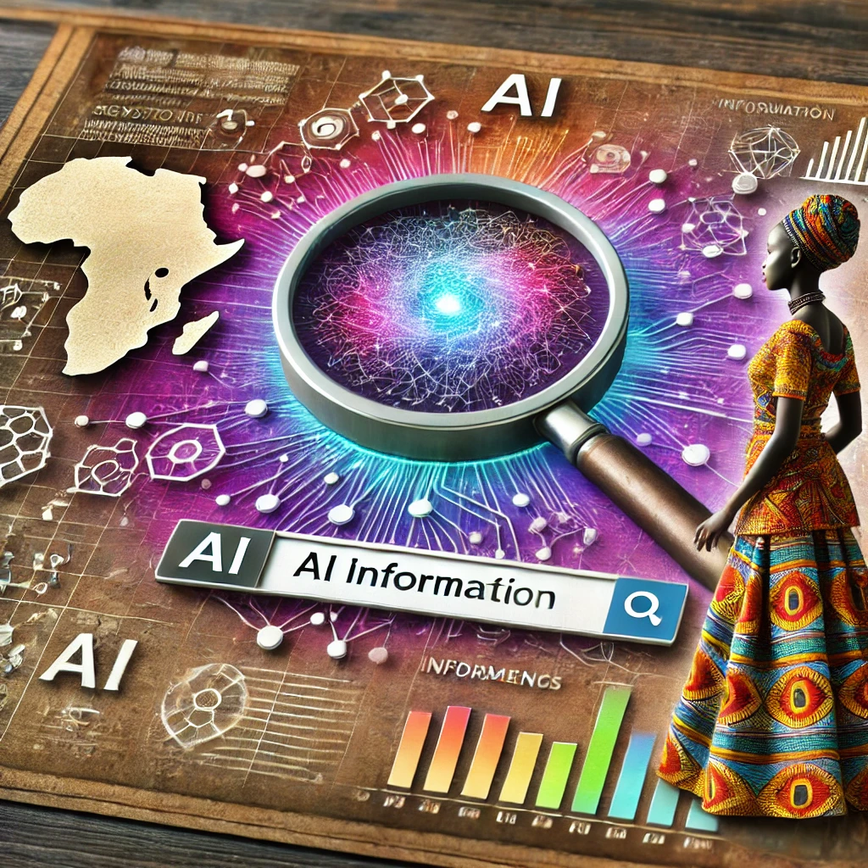
What are AI-Powered IR Systems?
These are IR systems enhanced with AI capabilities like machine learning and natural language understanding.
Global Examples:
-Google Search (USA).
- ChatGPT by OpenAI (USA).
- Yandex (Russia).
African Examples:
- Masakhane: AI-powered translation for African languages.
- Vula Mobile: Medical information retrieval for health professionals.

Slide 5
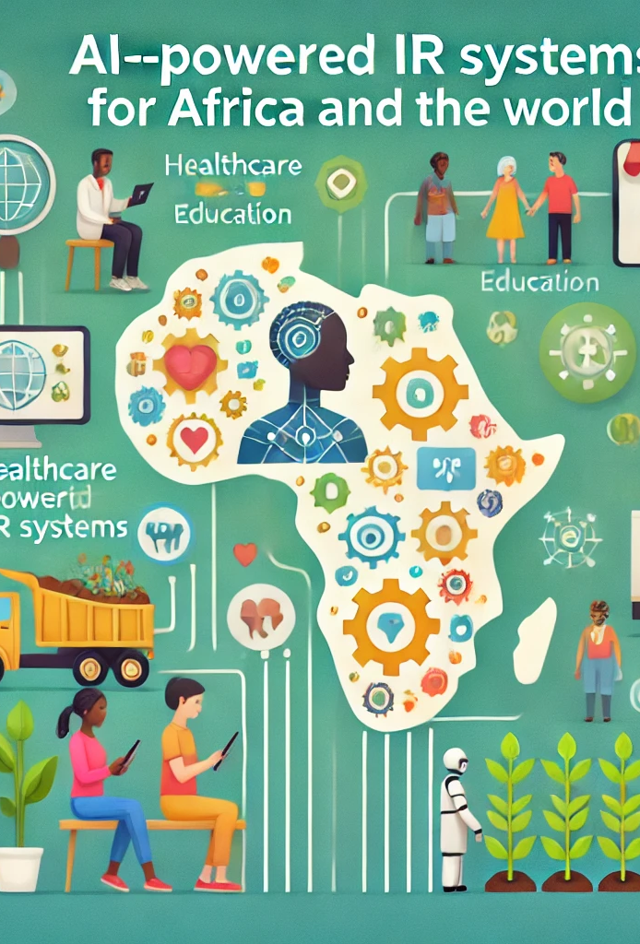
Benefits of AI-Powered IR Systems
For Africa and the World:
- Breaking language barriers.
- Access to local knowledge.
- Access to global knowledge.
- Improved healthcare.
- Improved education.
- Improved governance.
- Improved Agricultural activities.
- Improved fin-tech.
Specific Impacts:
- Enhanced agricultural productivity.
- Facilitated e-commerce and trade.

Slide 6
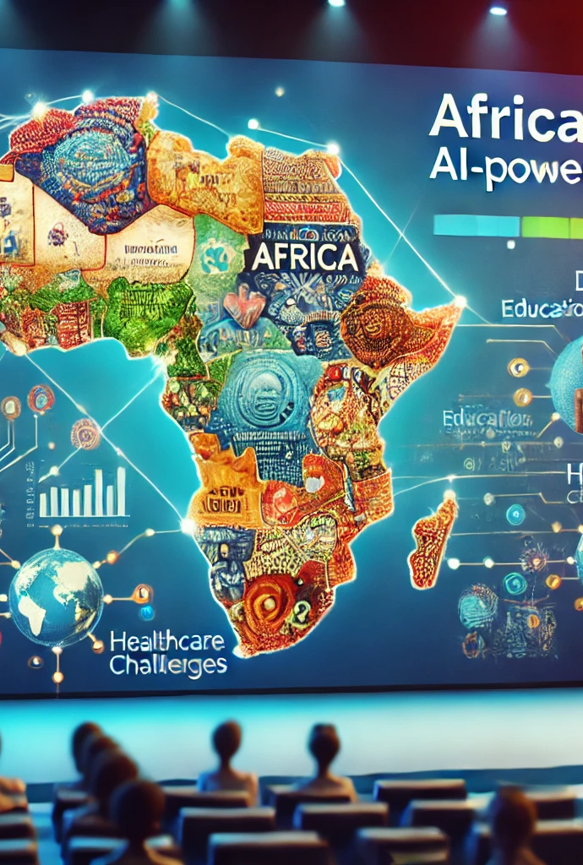
Why Africa Needs AI-Powered IR Systems
Africa Needs AI-Powered IR Systems because as a unique continent, it has its unique characteristics and challenges:
Africa’s unique challenges include:
- Limited access to reliable information.
- Limited technology infrastructure
- Limited food availability
- Insecurity.
- Gaps in digital literacy.
- Leapfrogging traditional infrastructure.
- Large underserved communities.

Slide 7
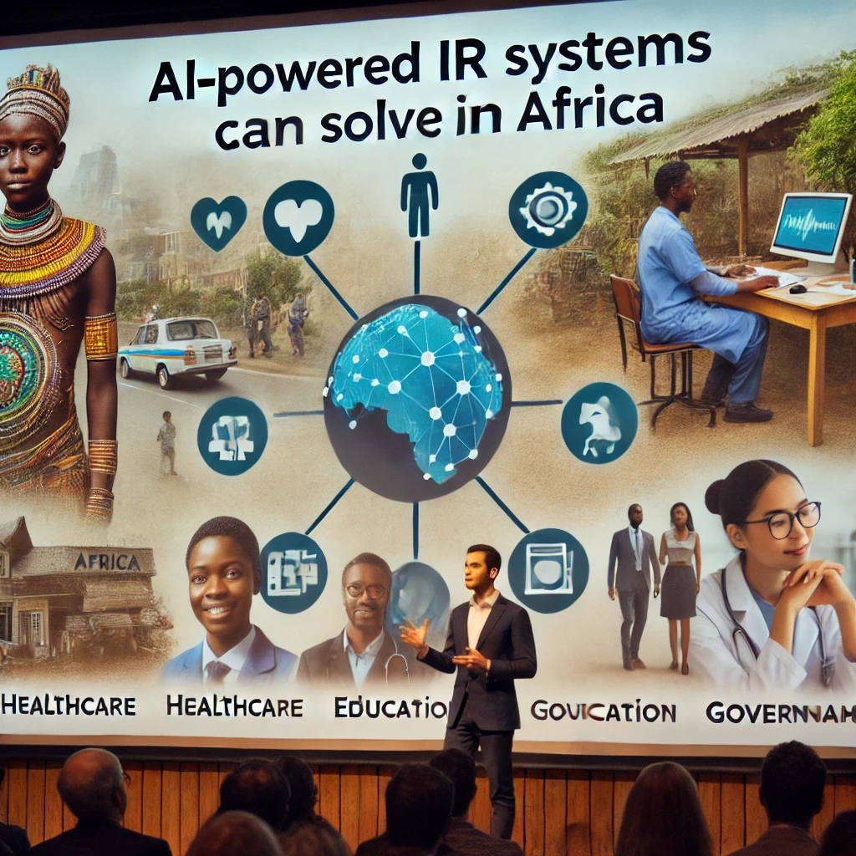
Problems AI-powered IR Systems Can Solve for Africa
AI-powered IR systems can help Africa in:
Bridging the information gap in education.
Bridging the information gap in Healthcare.
Bridging the information gap in Aviation.
Bridging the information gap in Financial sector.
Bridging the information gap in Agricultural sector.
Enhancing disaster management and response.
Supporting governance through data-driven decision-making.
Example: AI-powered tools for detecting and combating misinformation.

Slide 8
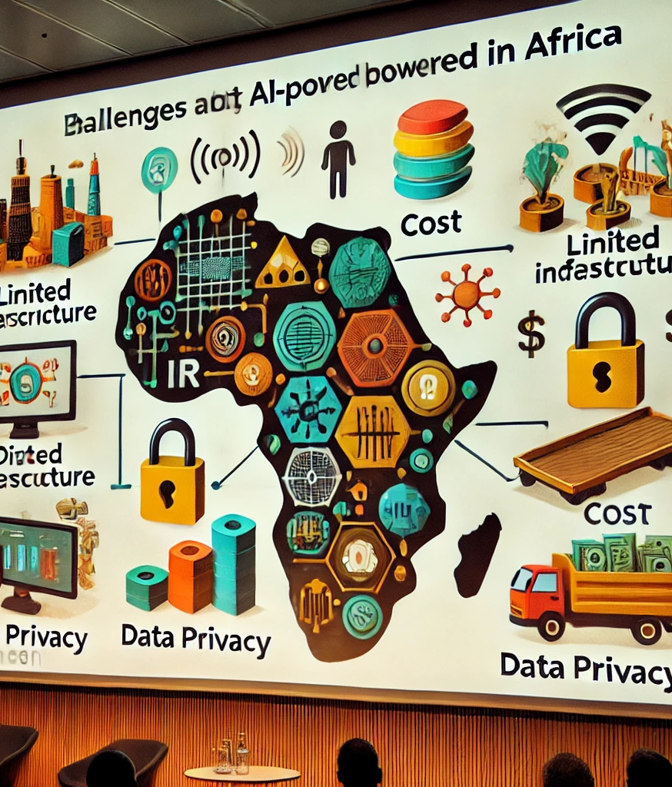
Challenges of Adopting AI-Powered IR Systems in Africa
Barriers:
- Limited digital infrastructure.
- High cost of technology adoption.
- Data privacy and ethical concerns.
- Low AI literacy.
- Weak Government policies
- Poor private sector involvement
- Limited investment in science and technology etc.

Slide 9
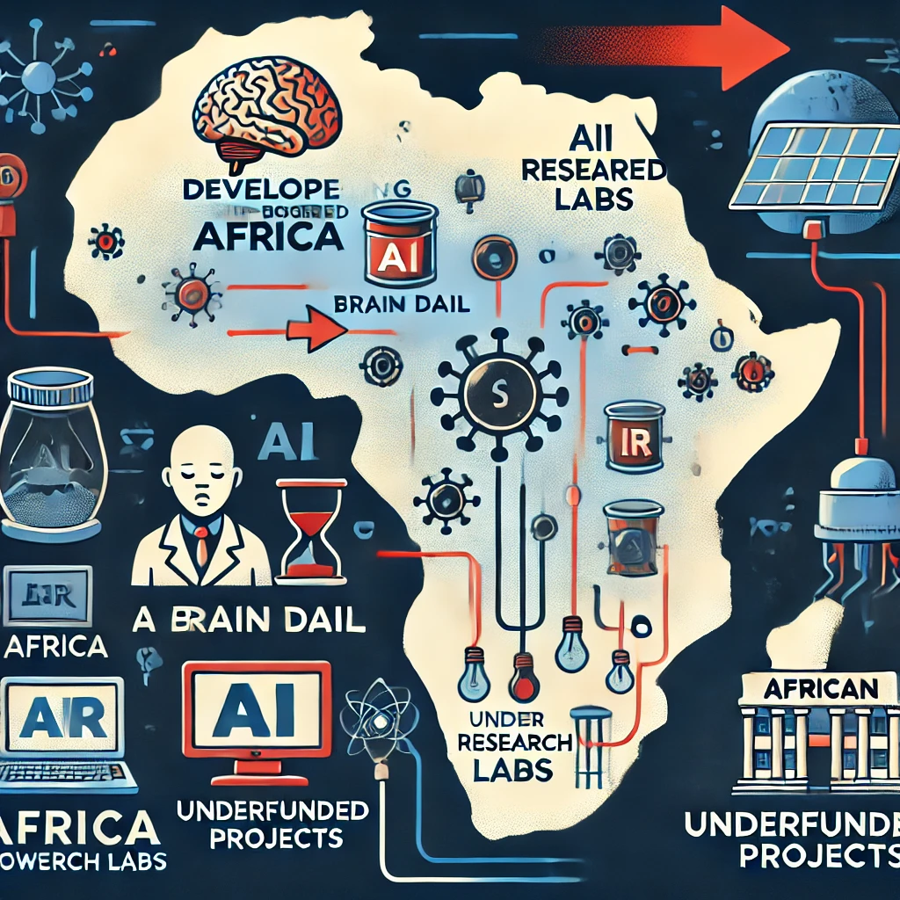
Challenges of Developing African-Based AI-Powered IR Systems
Issues:
- Scarcity of local datasets.
- Dependence on foreign technology.
- Brain drain of skilled professionals.
- Lack of investment in research and development

Slide 10
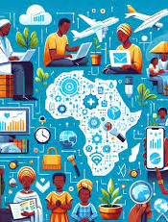
Why Africa Must Harness Its Resources
Opportunities:
- Rich cultural diversity.
- Rich linguistic diversity.
- Young, tech-savvy population.
- Untapped natural resources for tech development.
-Strategic Actions:
- Building AI talent pipelines.
- Creating policies to support innovation.

Slide 11
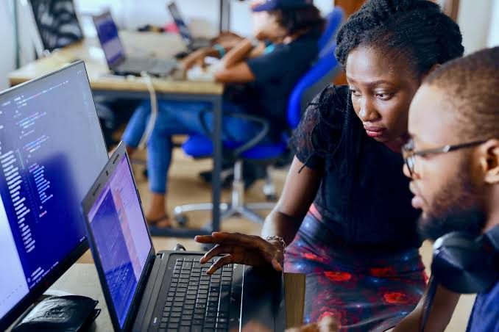
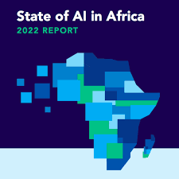
Examples of African AI-Powered IR Systems
Developed in Africa:
- M-Pesa’s financial information services.
- ABSA’s AI chatbots for customer service.
By Africans:
- SpeakAI for local language processing.
- AI solutions by African startups like Andela and DataProphet.

Slide 12
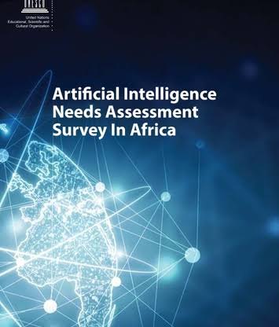
The Way Forward
Key Recommendations:
- Strengthen digital infrastructure.
- Promote AI education and capacity building.
- Encourage public-private partnerships.
- Support the creation of African datasets.

Slide 13

Conclusion
Key Takeaways:
- AI-powered IR systems can transform Africa’s access to information.
- Collaboration and investment are crucial for success.
- A brighter future depends on Africa’s ability to harness AI for its unique needs.

Slide 14




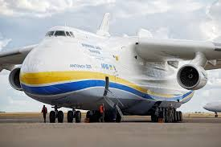
GRACIAS ASANTE SANA THANK YOU
FOR
LISTENING
DR. PROSPER OKORO ONYEKACHI
African Aviation and Aerospace University Abuja Nigeria

Slide 15
References
African Development Bank’s Report on Technology and Youth Empowerment (2023).
African Union’s Digital Transformation Strategy (2020-2030).
Manning, C.D., Raghavan, P., & Schütze, H. (2008).
ITU’s Report on AI in Developing Countries.
Introduction to Information Retrieval.
Masakhane project website; Vula Mobile official page.
McKinsey’s Report on AI in Africa (2023).
Profiles of leading African AI initiatives.
Recommendations from the African AI Summit 2023.
Russell, S., & Norvig, P. (2020). Artificial Intelligence: A Modern Approach.
UNESCO Report on AI for Sustainable Development (2022).
World Bank’s Digital Economy for Africa Report.

